Slide 1


DESIGN AND DEVELOPMENT OF PUF FOR HARDWARE SECURITY UPDATE
DEPARTMENT OF ELECTRONICS ENGINEERING
MIT CAMPUS, ANNA UNIVERSITY
BATCH : 2022-2026
Presented by:
Navabharathi T (2022504526)
Dharshan R (2022504517)
Lakshmanan S (2022504310)
Guided by:
Dr. V. R. Vijaykumar,
Professor,
Department of Electronics Engineering,
Madras Institute of Technology,
Anna University.

Slide 2
CONTENTS
OBJECTIVE
LITERATURE SURVEY
BLOCK DIAGRAM
SCHEMATIC DIAGRAM
CURRENT STATUS
FPGA IMPLEMENTATION RESULTS
FPGA IMPLEMENTATION FLOW & VALIDATION
ASIC IMPLEMENTATION FLOW
ASIC POST-SYNTHESIS ANALYSIS
SUMMARY
REFERENCES

Slide 3

OBJECTIVE
To develop a robust Arbiter PUF using Verilog HDL.
To analyze the uniqueness of the Arbiter PUF by generating responses to multiple challenges and comparing the responses across different PUF instances.
To evaluate various PUF metrices such as Inter-chip variation, Intra-chip variation, uniformity, reliability and bit-aliasing.
To implement the developed Arbiter PUF in FPGA platform, focusing on validating its functionality.

Slide 4
LITERATURE SURVEY
S.NO | AUTHOR | TITLE | JOURNAL DETAILS WITH YEAR | SIGNIFICANT CONTRIBUTION
1 | S. Hemavathy and V. S. Kanchana Bhaaskaran | “Arbiter PUF—A Review of Design, Composition, and Security Aspects ” | IEEE Access, vol. 11, pp. 33979–33993, 2023 | Inference: Provided a comprehensive review of Arbiter PUF designs, metrics, and their resilience against ML attacks. Many existing PUF architectures are still susceptible to deep learning and side-channel modeling.
2 | Sivappriya Manivannan, Rajat Subhra Chakraborty, Indrajit Chakrabarti, and Jothi Ramalingam | “Practical and Efficient PUF-Based Protocol for Authentication and Key Agreement in IoT” | IEEE Embedded Systems Letters, vol. 16, no. 2, pp. 118–121, 2024 | Inference: Proposed a lightweight authentication and key agreement protocol using Arbiter PUF, Fuzzy Extractor, and ECDH. Problem Identified: Conventional systems store large CRP sets or require pairing operations—both unsuitable for IoT.

Slide 5
LITERATURE SURVEY
S.NO | AUTHOR | TITLE | JOURNAL DETAILS WITH YEAR | SIGNIFICANT CONTRIBUTION
3 | Jim Plusquellic, Eirini Eleni Tsiropoulou, and Cyrus Minwalla | “Privacy-Preserving Authentication Protocols for IoT Devices Using the SiRF PUF” | IEEE Transactions on Emerging Topics in Computing, vol. 11, no. 4, pp. 918–931, 2023 | Inference: Developed COBRA and PARCE protocols using SiRF PUF that enhance privacy without leaking CRPs. Problem Identified: Conventional strong PUFs are vulnerable to model-building and response-leakage attacks.
4 | Fadi Farha, Huansheng Ning, Karim Ali, Liming Chen, and Christopher Nugent | “SRAM-PUF-Based Entities Authentication Scheme for Resource-Constrained IoT Devices | IEEE Internet of Things Journal, vol. 8, no. 7, pp. 5904–5914, 2021 | Inference: Proposed a lightweight SRAM-PUF authentication scheme suitable for low-power IoT devices. Problem Identified: SRAM-PUFs suffer from noise and entropy issues, especially under changing environmental conditions.

Slide 6
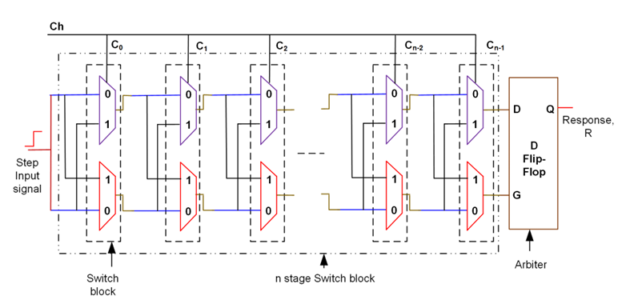
BLOCK DIAGRAM

Slide 7
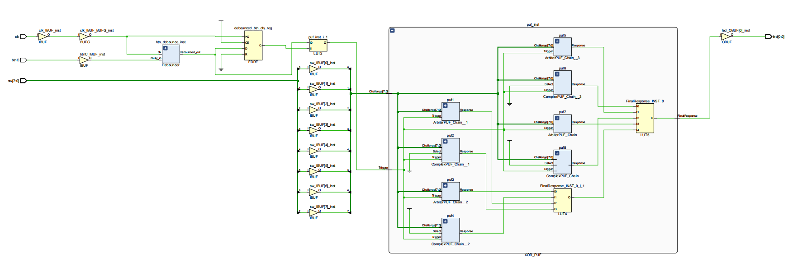
SCHEMATIC DIAGRAM

Slide 8
CURRENT STATUS
Stability:Achieved 98.8% response repeatability using UART-based manual verification, ensuring reliable and consistent responses.
Uniqueness:Recorded 44.26% inter-chip uniqueness using UART-basedtesting.
Reason: Vivado’s automatic placement and routing still cause similar delay paths across FPGAs.
Conclusion:Maintained high stability (98.8%) with improved uniqueness (44.26%) using UART-based manual testing; uniqueness remains limited by FPGA routing optimization.

Slide 9
FPGA IMPLEMENTATION RESULTS
The performance of the PUF was evaluated based on industry-standard metrics.
Stability: The design achieved 98.8% stability, demonstrating high reliability and consistency of the response bits across varying environmental conditions.
Uniqueness: The inter-chip Hamming distance analysis yielded a uniqueness score of 16.47% (for 8-bit responses), which is below the ideal value of 50%, indicating limited device-specific differentiation among the FPGA devices.

Slide 10
FPGA Implementation Flow & Validation
The design was implemented on an FPGA using the Xilinx Vivado Design Suite, following a standard RTL-to-bitstream methodology.
The flow consisted of RTL design, followed by logic synthesis, and finally place and route (P&R) to generate the device-specific bitstream.
Timing closure was successfully achieved by analyzing and meeting setup and hold time requirements, indicated by a positive Worst Negative Slack (WNS) and zero Total Negative Slack (TNS). Resource utilization was monitored to ensure design efficiency.
Functional validation was conducted on the hardware through manual testing, using a UART interface to send challenges and receive responses from the PUF.

Slide 11
ASIC IMPLEMENTATION FLOW
SYNTHESIS:
The RTL code was synthesized for an ASIC using Cadence Genus.
The synthesis produced a gate-level netlist and an SDC file describing the timing requirements.
The design targets the SCL 180 nm technology and includes I/O pad cells from the SCL PDK.
The final netlist is now ready for physical design steps such as floorplanning, power planning, and PNR.

Slide 12
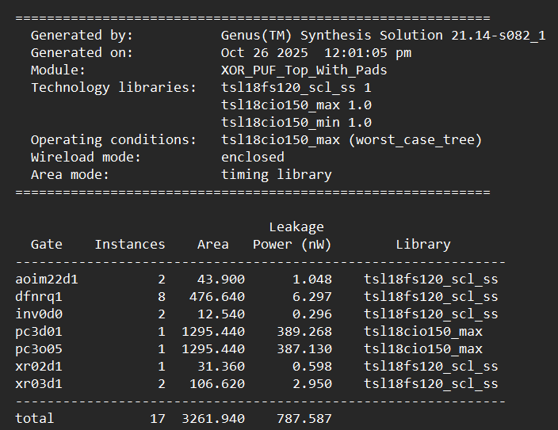
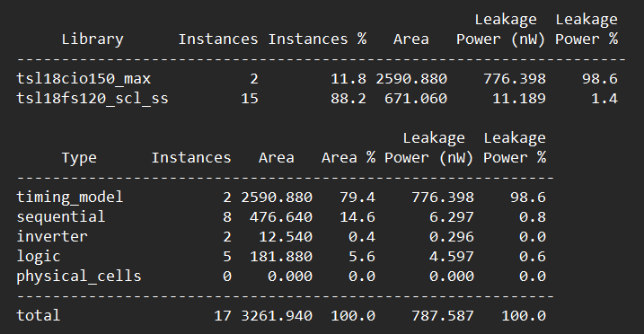
ASIC POST-SYNTHESIS ANALYSIS
Cell & Path Report (syn_opt_gates.rpt): Provides a breakdown of standard cell counts, overall logic depth, and a detailed analysis of the critical timing paths in the design.

Slide 13
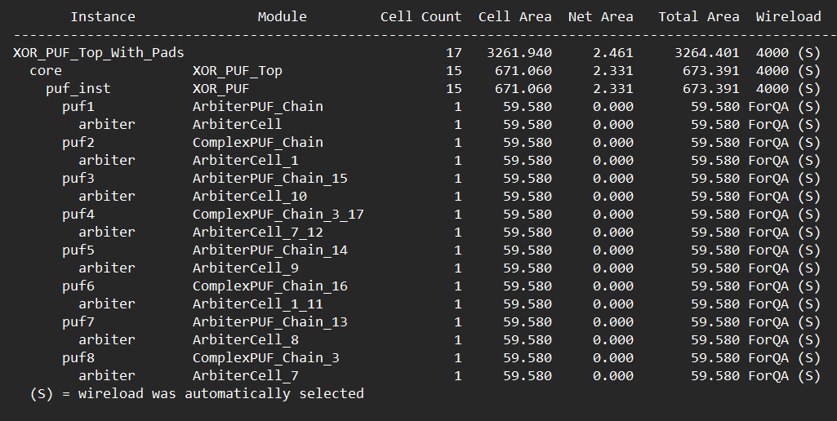
ASIC POST-SYNTHESIS ANALYSIS
Area Report (area.rpt): Confirms the total combinational and non-combinational cell area, with a hierarchical breakdown for each module.

Slide 14
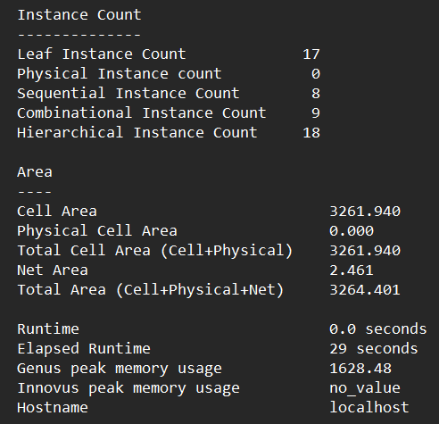
ASIC POST-SYNTHESIS ANALYSIS
Quality of Result Report (qor.rpt): Indicates a clean synthesis run with no unconstrained paths, acceptable WNS/TNS, and no violations for maximum transition or maximum fanout design rules.

Slide 15
Apply manual floorplanning or routing constraints in Vivado to try to preserve physical delay differences.
Explore alternative PUF architectures (e.g., XOR Arbiter PUF, RO-PUF) or different FPGA families for improved uniqueness.
Perform environmental testing (temperature/voltage) to further evaluate robustness.
Prepare hardware demo and metric comparison table for the next review.
SUMMARY
8-Bit PUF Analysis
Metric | Value | Calculation / Comment
Total Challenges / Bits | 255 | Based on an 8-bit challenge space (2⁸−1)
Ones in Response FPGA 1 | 118 (46.27%) | Nearly balanced, indicating good randomness
Ones in Response FPGA 2 | 114 (44.71%) | Nearly balanced, indicating good randomness
Flipped Bits (Inter-Chip HD) | 42 | The number of bits that differ between two FPGAs
Uniqueness | 16.47% | (42/255)×100 Low result (ideal ≈ 50%)
Stability | 98.8% | High reliability, suitable for security applications

Slide 16
Apply manual floorplanning or routing constraints in Vivado to try to preserve physical delay differences.
Explore alternative PUF architectures (e.g., XOR Arbiter PUF, RO-PUF) or different FPGA families for improved uniqueness.
Perform environmental testing (temperature/voltage) to further evaluate robustness.
Prepare hardware demo and metric comparison table for the next review.
SUMMARY
16-Bit PUF Analysis
Metric | Value | Calculation / Comment
Total Challenges / Bits | 65,536 | Based on a 16-bit challenge space (2¹⁶)
Ones in Response FPGA 1 | 32,437 (49.50%) | Excellent balance, close to the ideal 50%
Ones in Response FPGA 2 | 32,628 (49.79%) | Excellent balance, close to the ideal 50%
Flipped Bits (Inter-Chip HD) | 28,996 | The number of bits differing between FPGA 1 and FPGA 2
Uniqueness | 44.26% | Strong result, approaching the ideal 50%
Stability | 98.8% | High reliability, suitable for security applications

Slide 17
REFERENCES
J.Plusquellic and M.Areno,“Correlation-based robust authentication(cobra) using helper data only,” Cryptography, vol. 2, no. 3, 2018, Art. no. 21. [Online]. Available: https://www.mdpi.com/2410--387X/2/3/21
D.Heeger and J. Plusquellic, “Analysis of IoT authentication over LoRa,” in Proc. IEEE 16th Int. Conf. Distrib. Comput. Sensor Syst., 2020, pp. 458–465.
J.Plusquellic, “Shift register, reconvergent-fanout (SiRF) PUF implementation on an FPGA,” Cryptography, vol. 6, no. 4, 2022, Art. no. 59. [Online]. Available: https://www.mdpi.com/2410--387X/6/4/59
U. Rührmair et al., “PUF modeling attacks on simulated and silicon data,” IEEE Trans. Inf. Forensics Security, vol. 8, no. 11, pp. 1876–1891, Nov. 2013.
G. T. Becker, “On the pitfalls of using Arbiter-PUFs as building blocks,” IEEE Trans. Comput.-Aided Design Integer. Circuits Syst., vol. 34, no. 8, pp. 1295–1307, Aug. 2015.

Slide 18
REFERENCES(Cntd.)
Y. Wen and Y. Lao, “Enhancing PUF reliability by machine learning,” in Proc. IEEE Int. Symp. Circuits Syst., 2017, pp. 1–4.
H.Awano, T.Iizuka and M.Ikeda “PUF Net :A deep neural network based modeling attack for physically unclonable function,” in Proc. IEEE Int. Symp. Circuits Syst., 2019, pp. 1–4.
Y. Xu, Y. Lao, W. Liu, Z. Zhang, X. You, and C. Zhang, “Mathematical modeling analysis of strong physical unclonable functions,” IEEE Trans. Comput.-Aided Design Integer. Circuits Syst., vol. 39, no. 12, pp. 4426–4438, Dec. 2020.
J. Delvaux, “Machine-learning attacks on PolyPUFs, OB-PUFs, RPUFs, LHS-PUFs and PUF-FSMs,”IEEETrans.Inf.Forensics Security, vol. 14, no. 8, pp. 2043–2058, Aug. 2019.
Y. Lao and K. K. Parhi, “Statistical analysis of MUX-based physical unclonablefunctions,”IEEETrans.Comput.-AidedDesignIntegr.Circuits Syst., vol. 33, no. 5, pp. 649–662, May 2014.

Slide 19
THANK YOU

